Slide 1
Phase space structures in the Helium atom

Slide 2
Main Objective
The main goal was given an eZe configuration of a Helium atom and the initial conditions.
Which electron escapes?
To do this development of additional software was needed

Slide 3
Software that was developed
mpl_trajectory
Runge Kutta
Phase Space Plotter
Lagragain Movement

Slide 4
mpl_trajectory
This python module was developed to give a visual representation of the results.
It is a PyPi module
Can be installed by using pip
It has documentation hosted by read the docs at https://mpl-trajectory.readthedocs.io/en/latest/

Slide 5
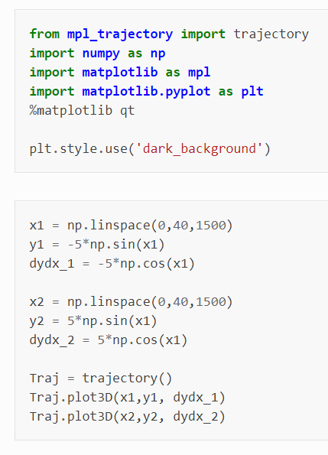
What does mpl_trajectory do
It creates animations for n-body problems
These animations are 2D but have an option of using colour to make them 3D.
Notes:
Two sin waves with z being gradient

Slide 6
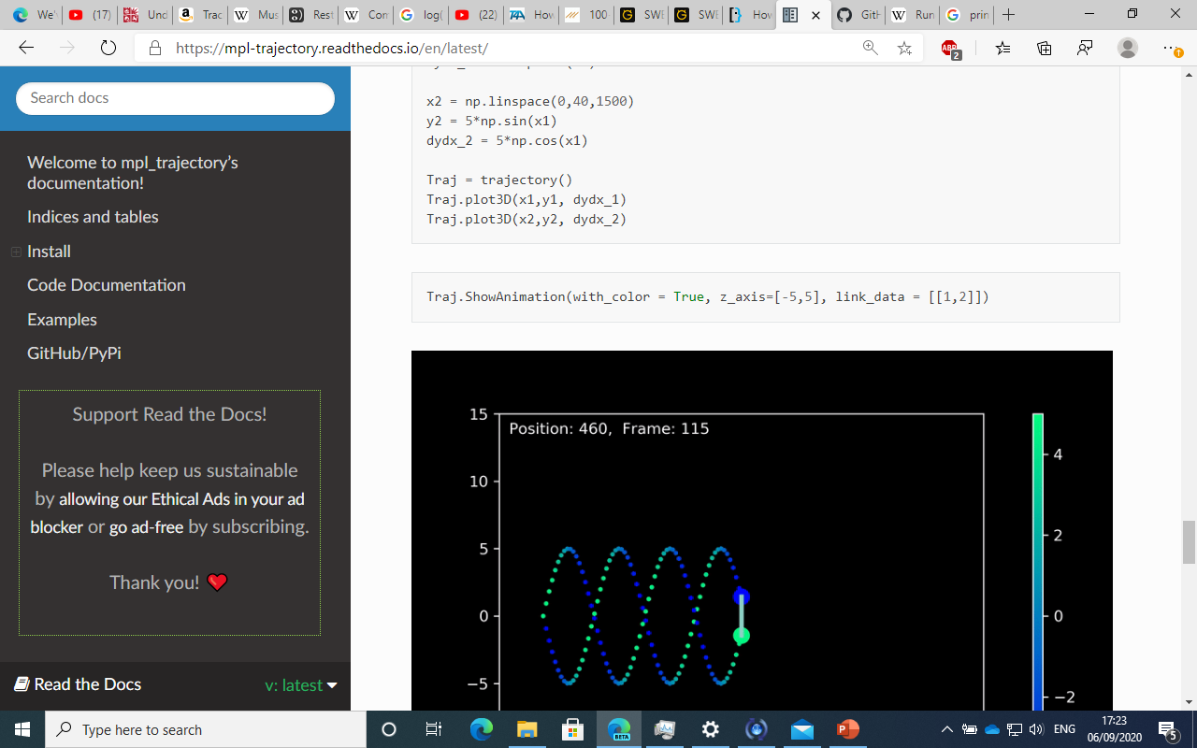
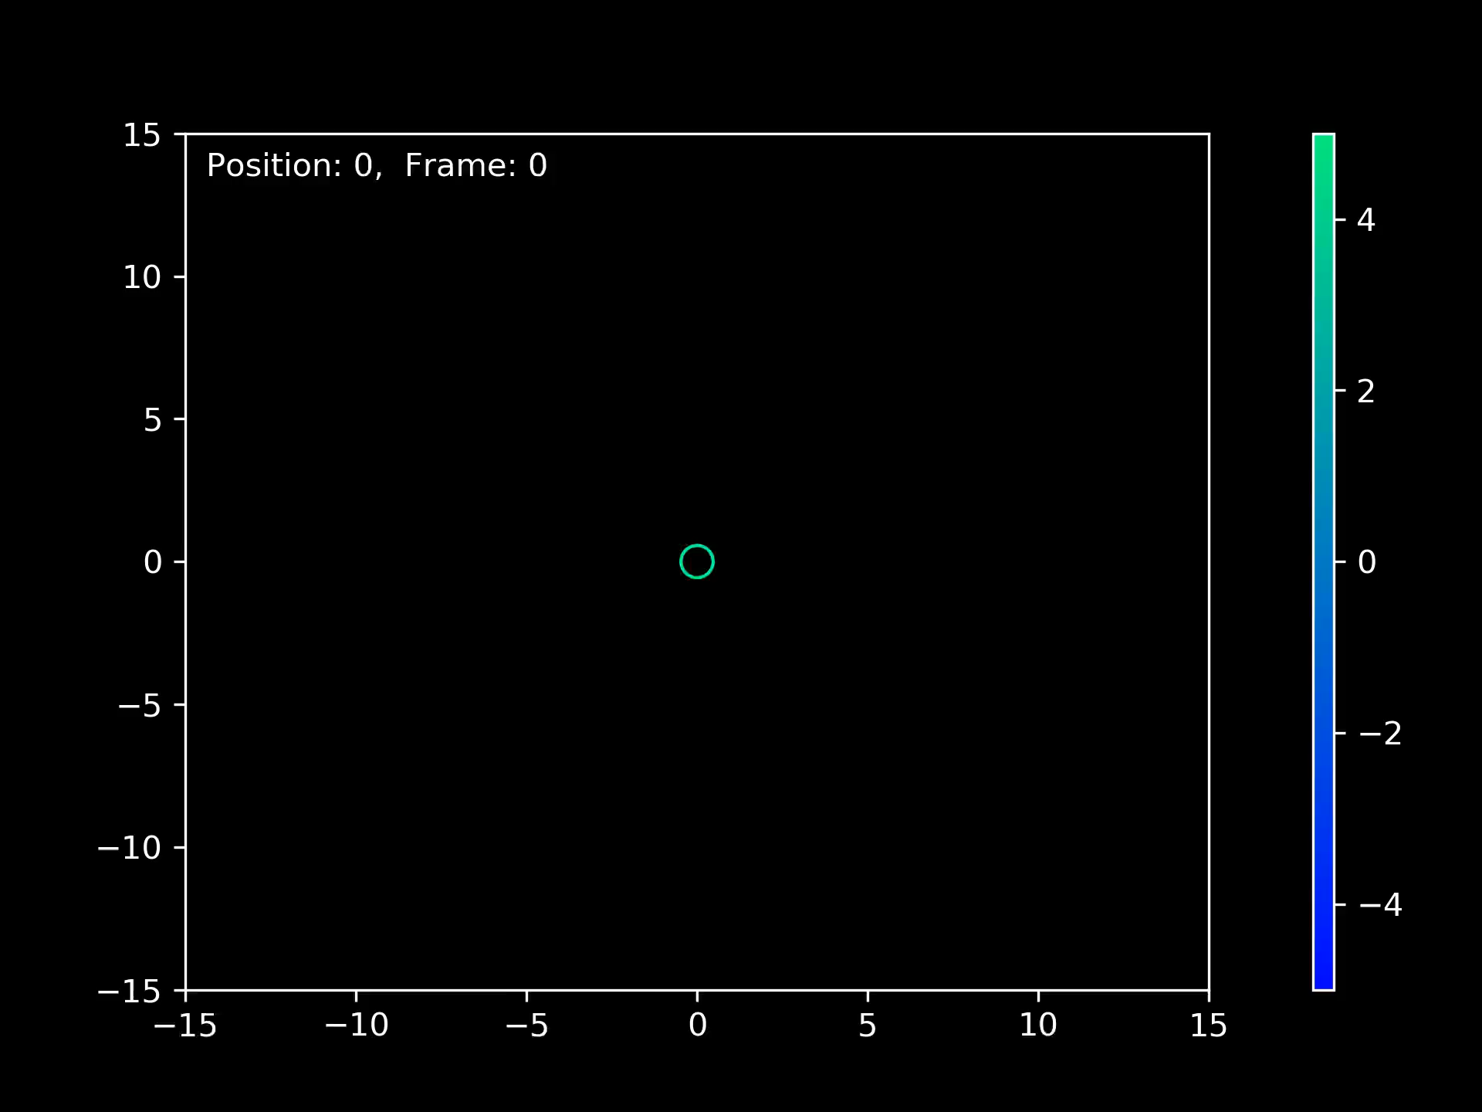

Slide 7
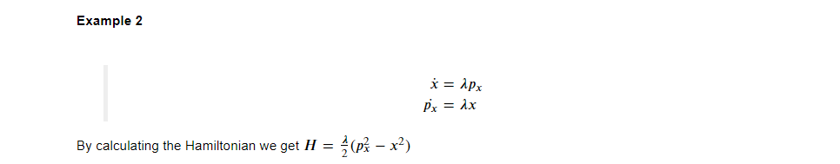
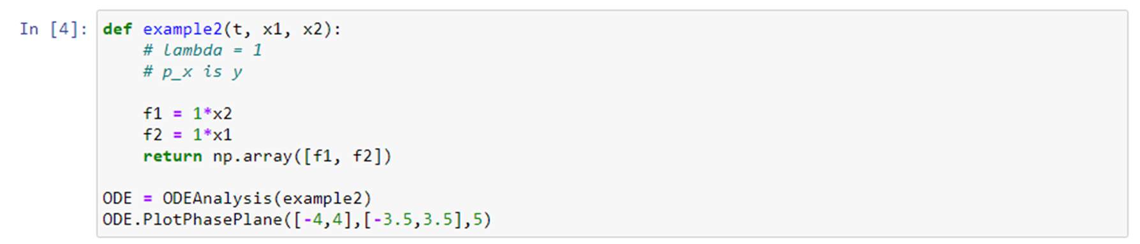
Phase Space Plotter
Notes:
Maybe add description of what each does

Slide 8
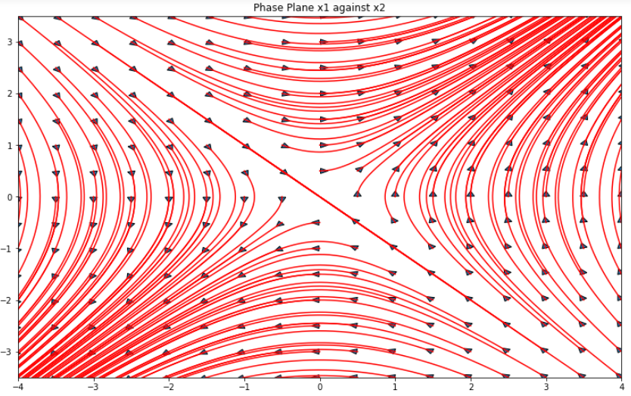

Slide 9
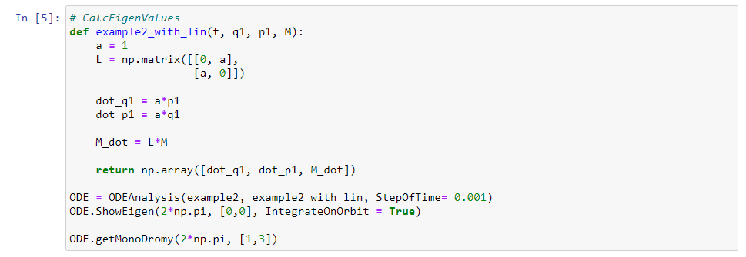
Now With Monodromy Matrix
Used to work out stability of a periodic orbit

Slide 10
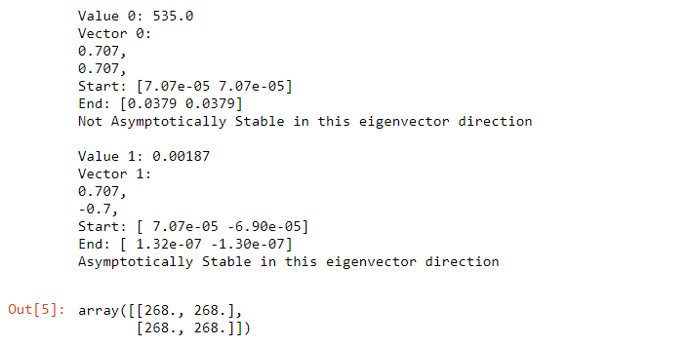
There are more examples of higher degrees of freedom int the notebook n-dof Hamiltonian examples on GitHub repository
But the problem with this, the linearisation matrix would have to be calculated by hand
We can automate this, this is needed for more complicated examples
Notes:
n-dof Hamitonian examples has more examples, with going into higher degrees of freedom

Slide 11
Custom Hamiltonian
Get the Hamiltonian ODE’s from a custom setup
The Supported Energies Are:
Kinetic Energy
Linear gravitational PE
Radial gravitational PE
Elastic PE
Radial Charge PE
Notes:
To deal with this created

Slide 12
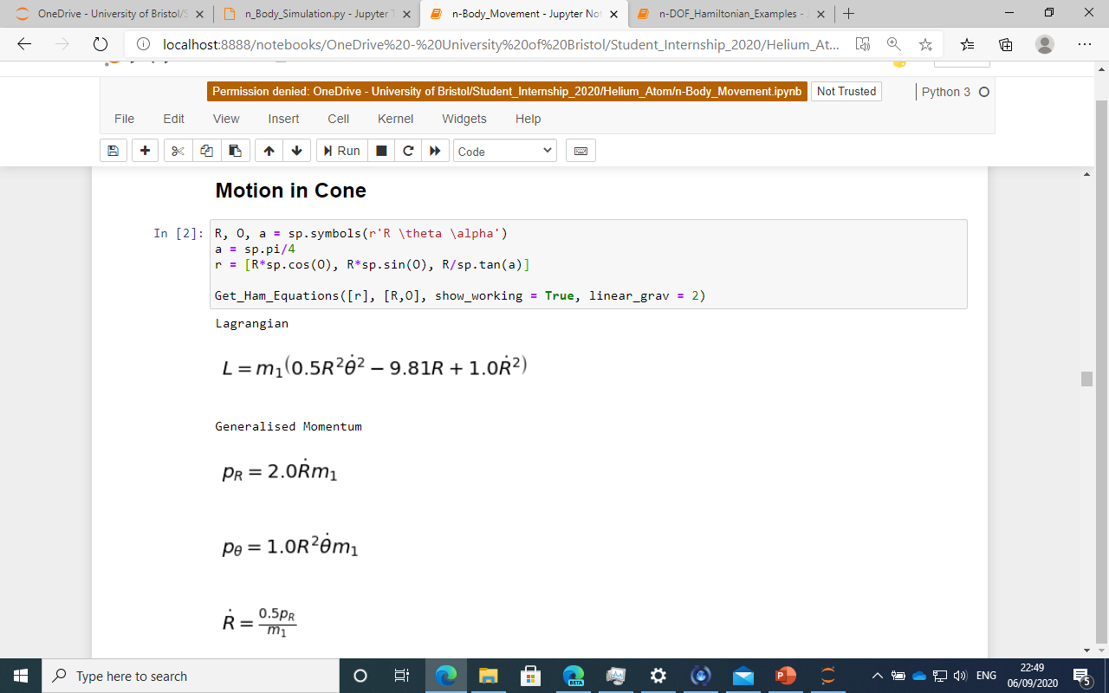
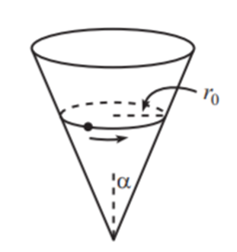
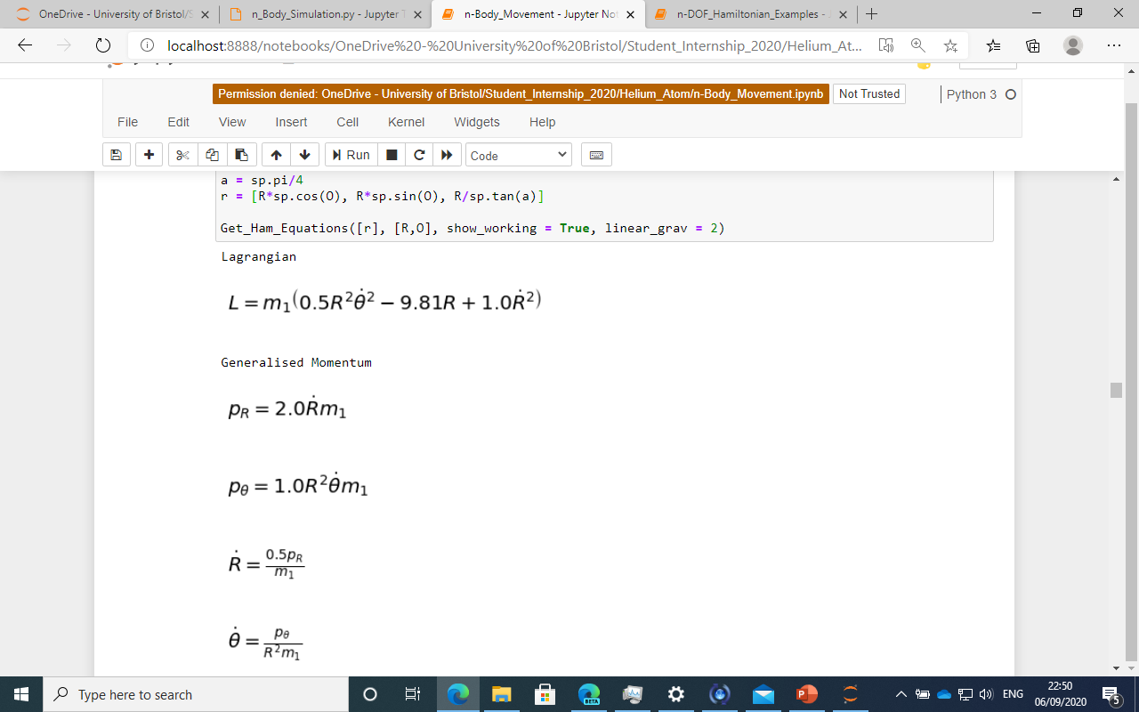
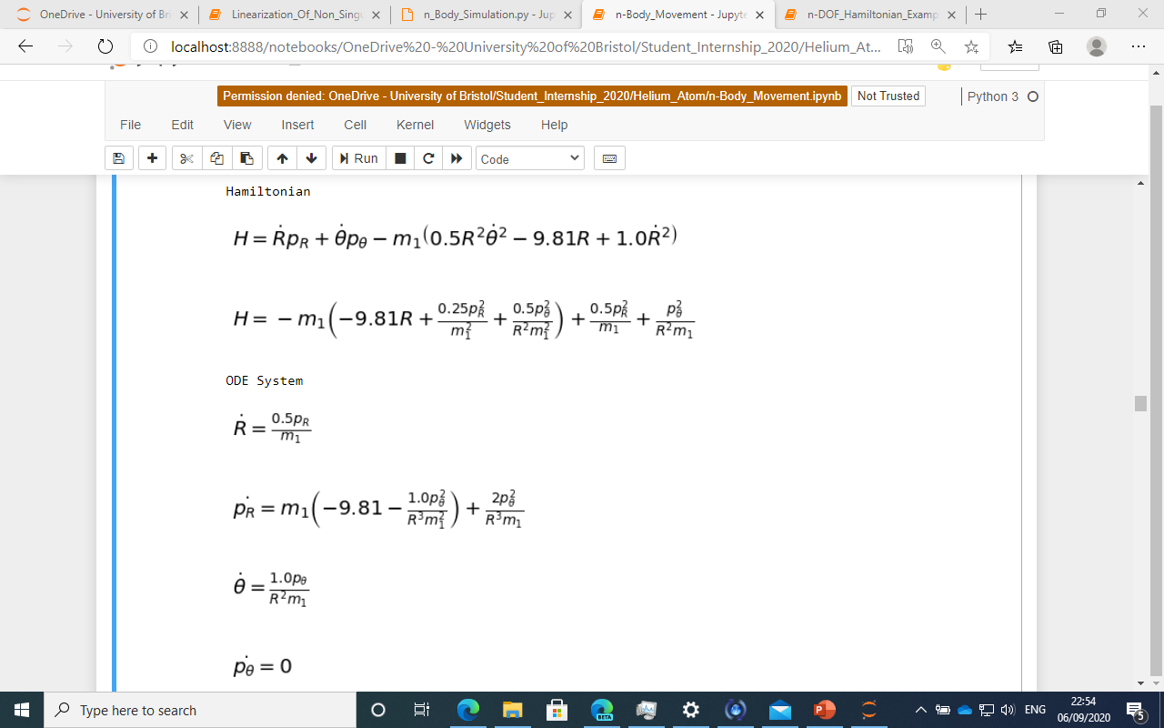
This is a symbolic program, meaning if given a lagrangain type question. All the user needs to do is work out the position of the particles.
Then when the Hamiltonian equations are calculated, it goes into the mpl_trajectory module. To get outputs given on next slide.
Notes:
Say more symbolic program
Remove runge kutta
Explain explosions

Slide 13
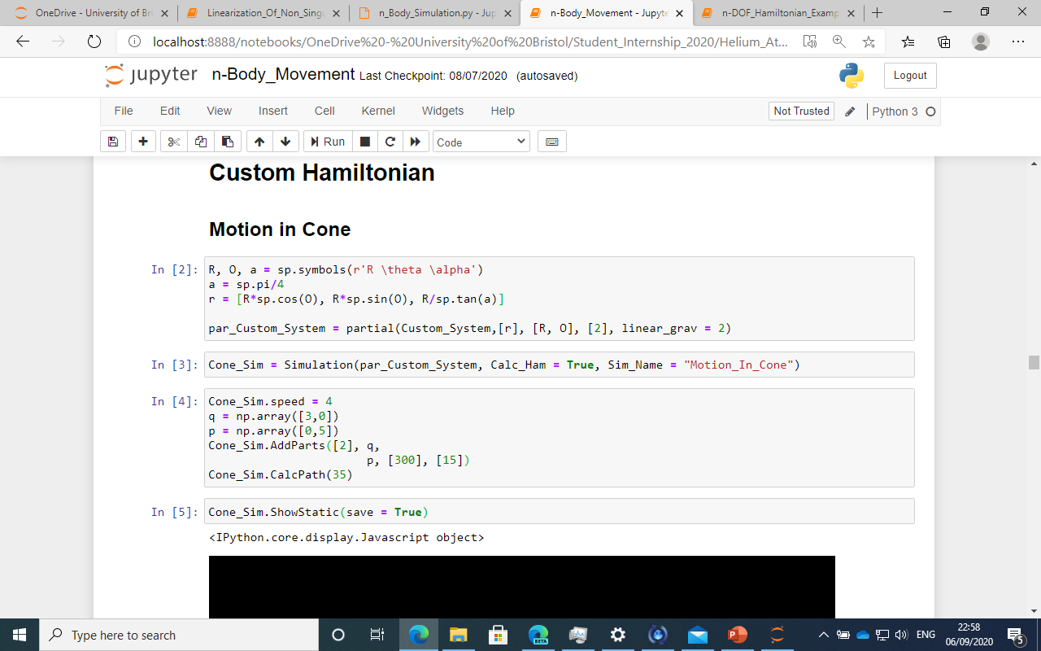
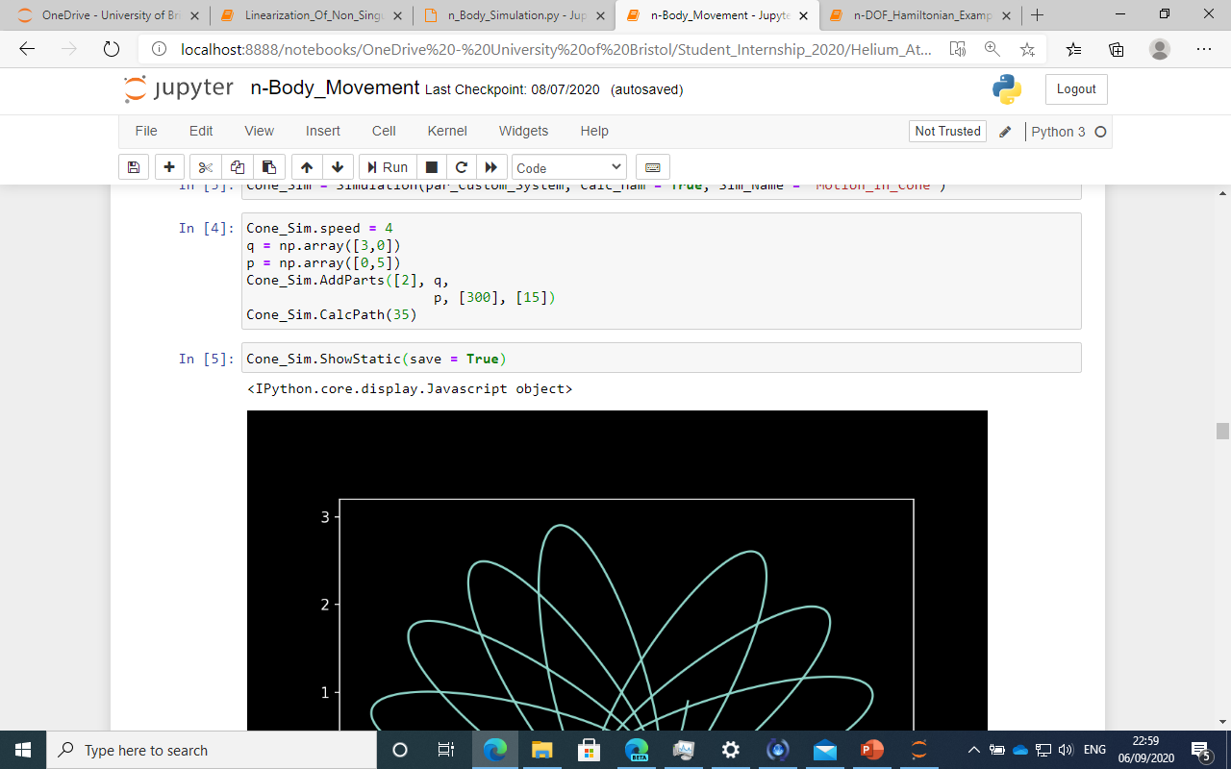
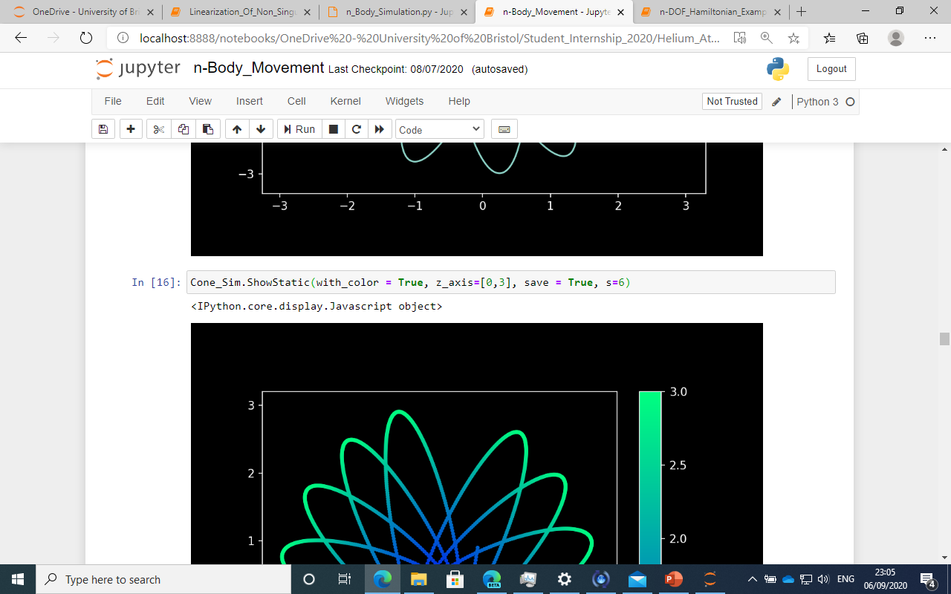
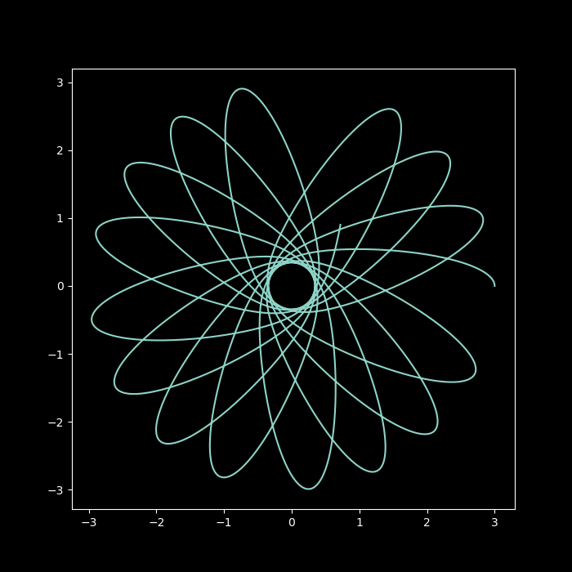
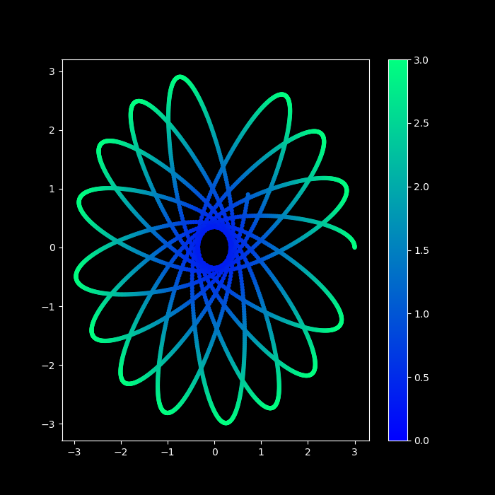

Slide 14
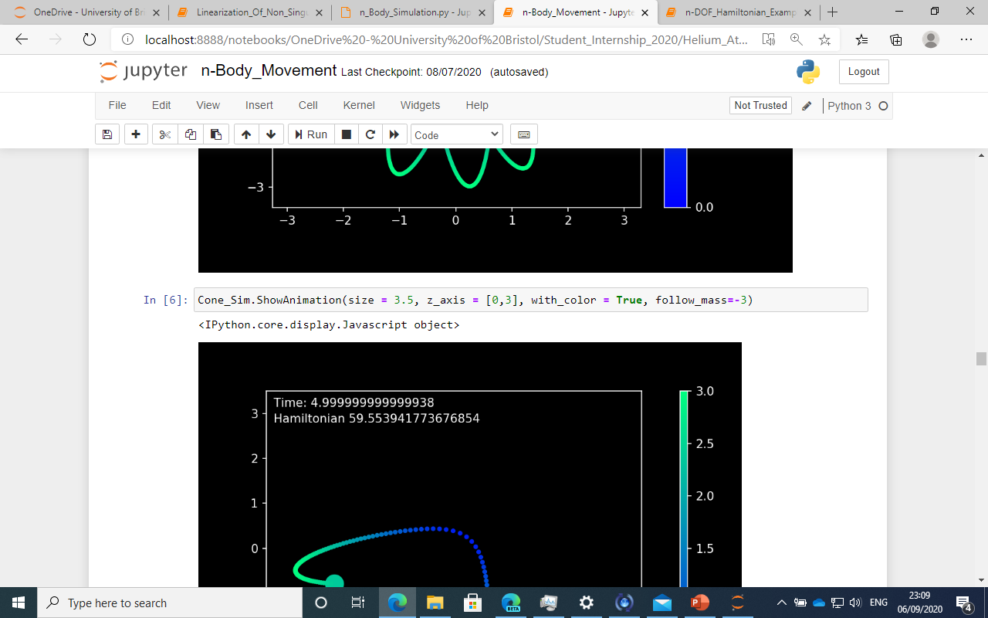
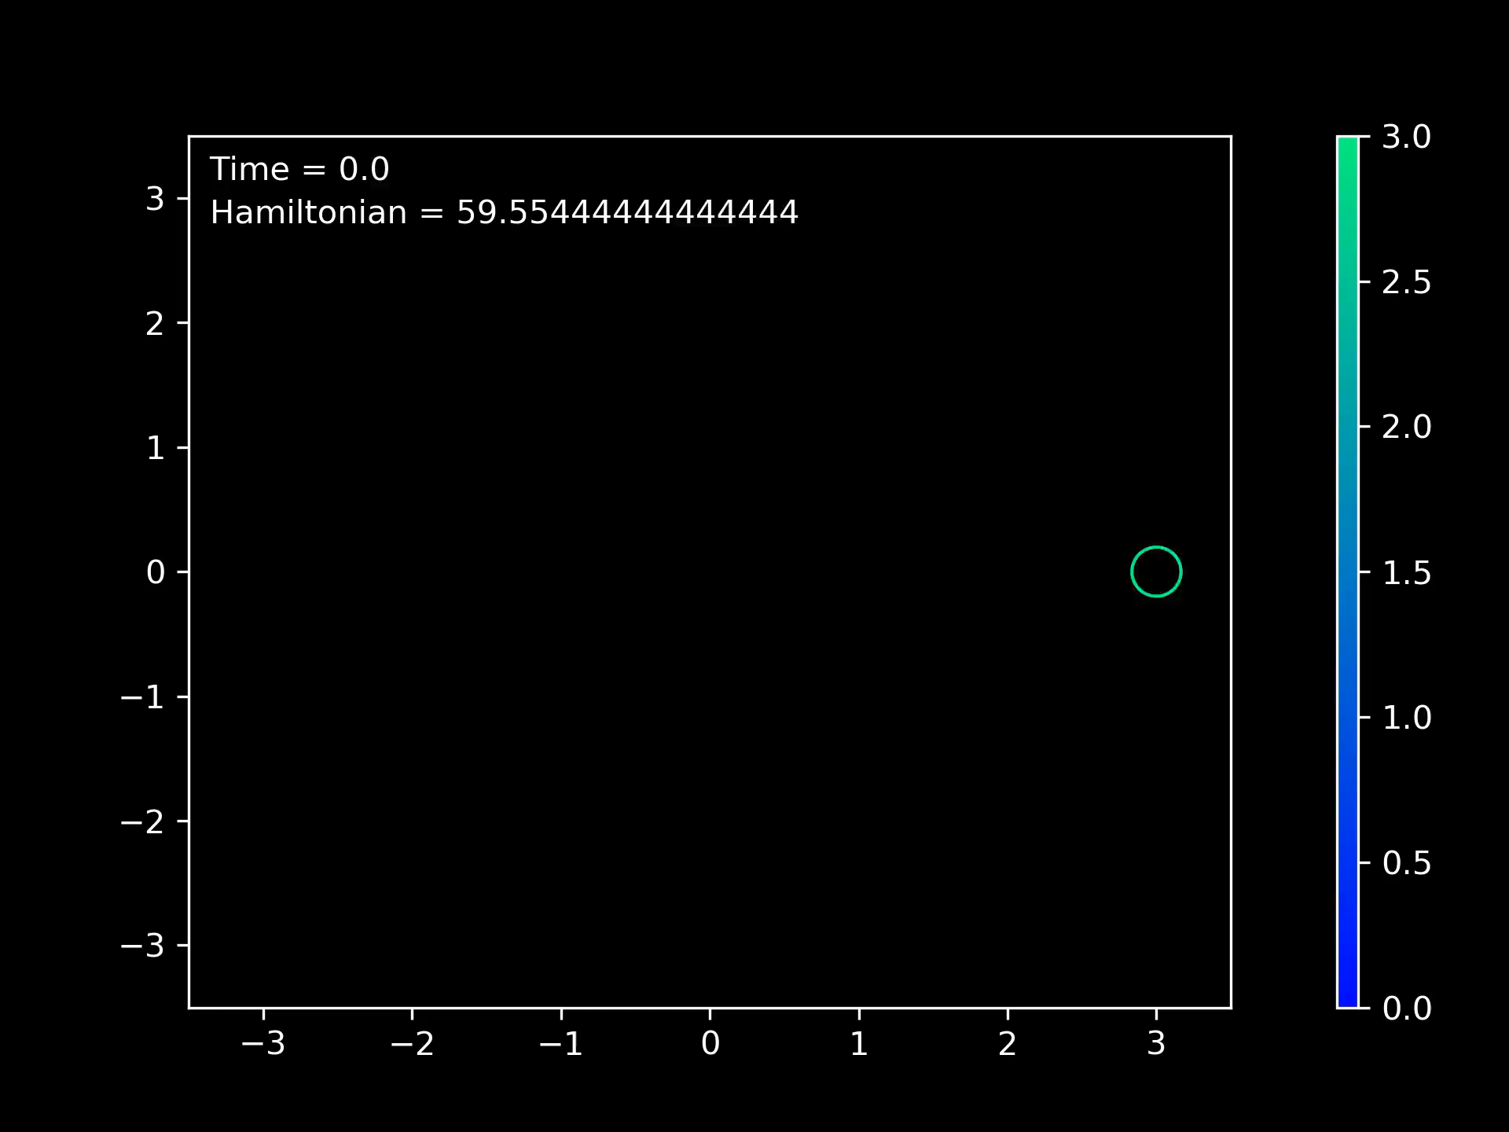

Slide 15
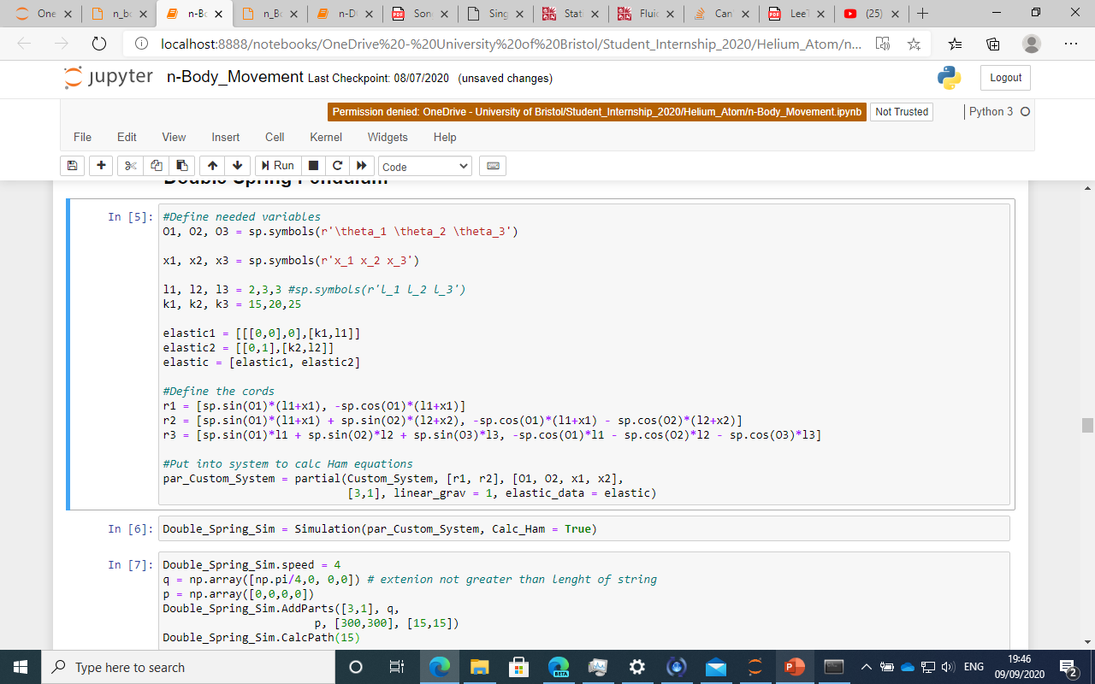
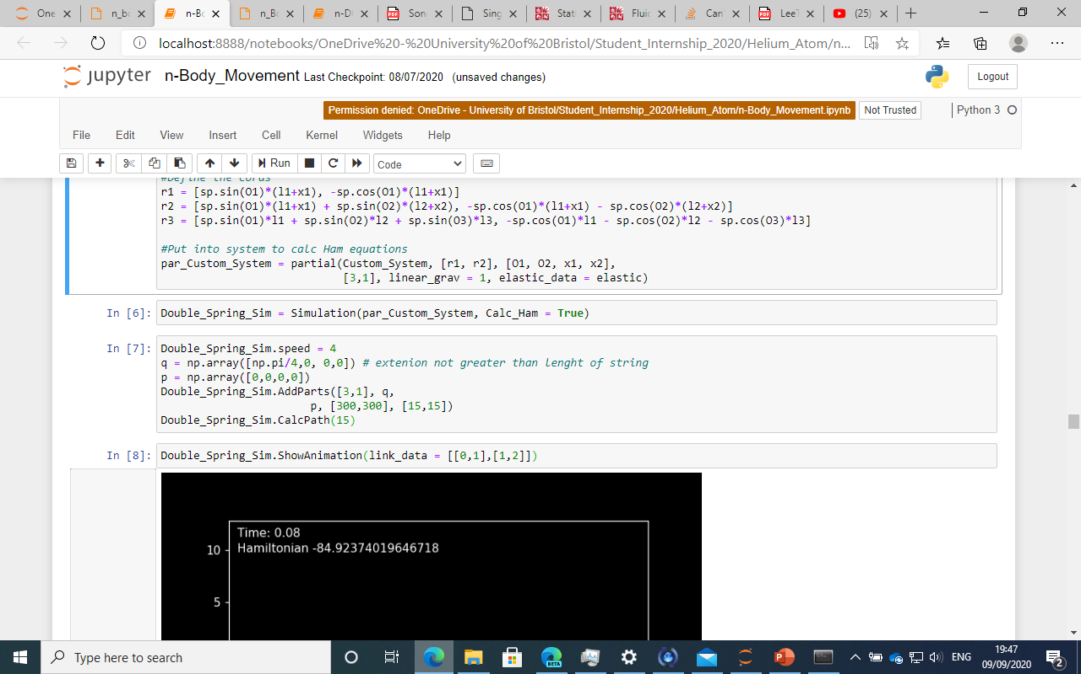
Double Spring Pendulum

Slide 16

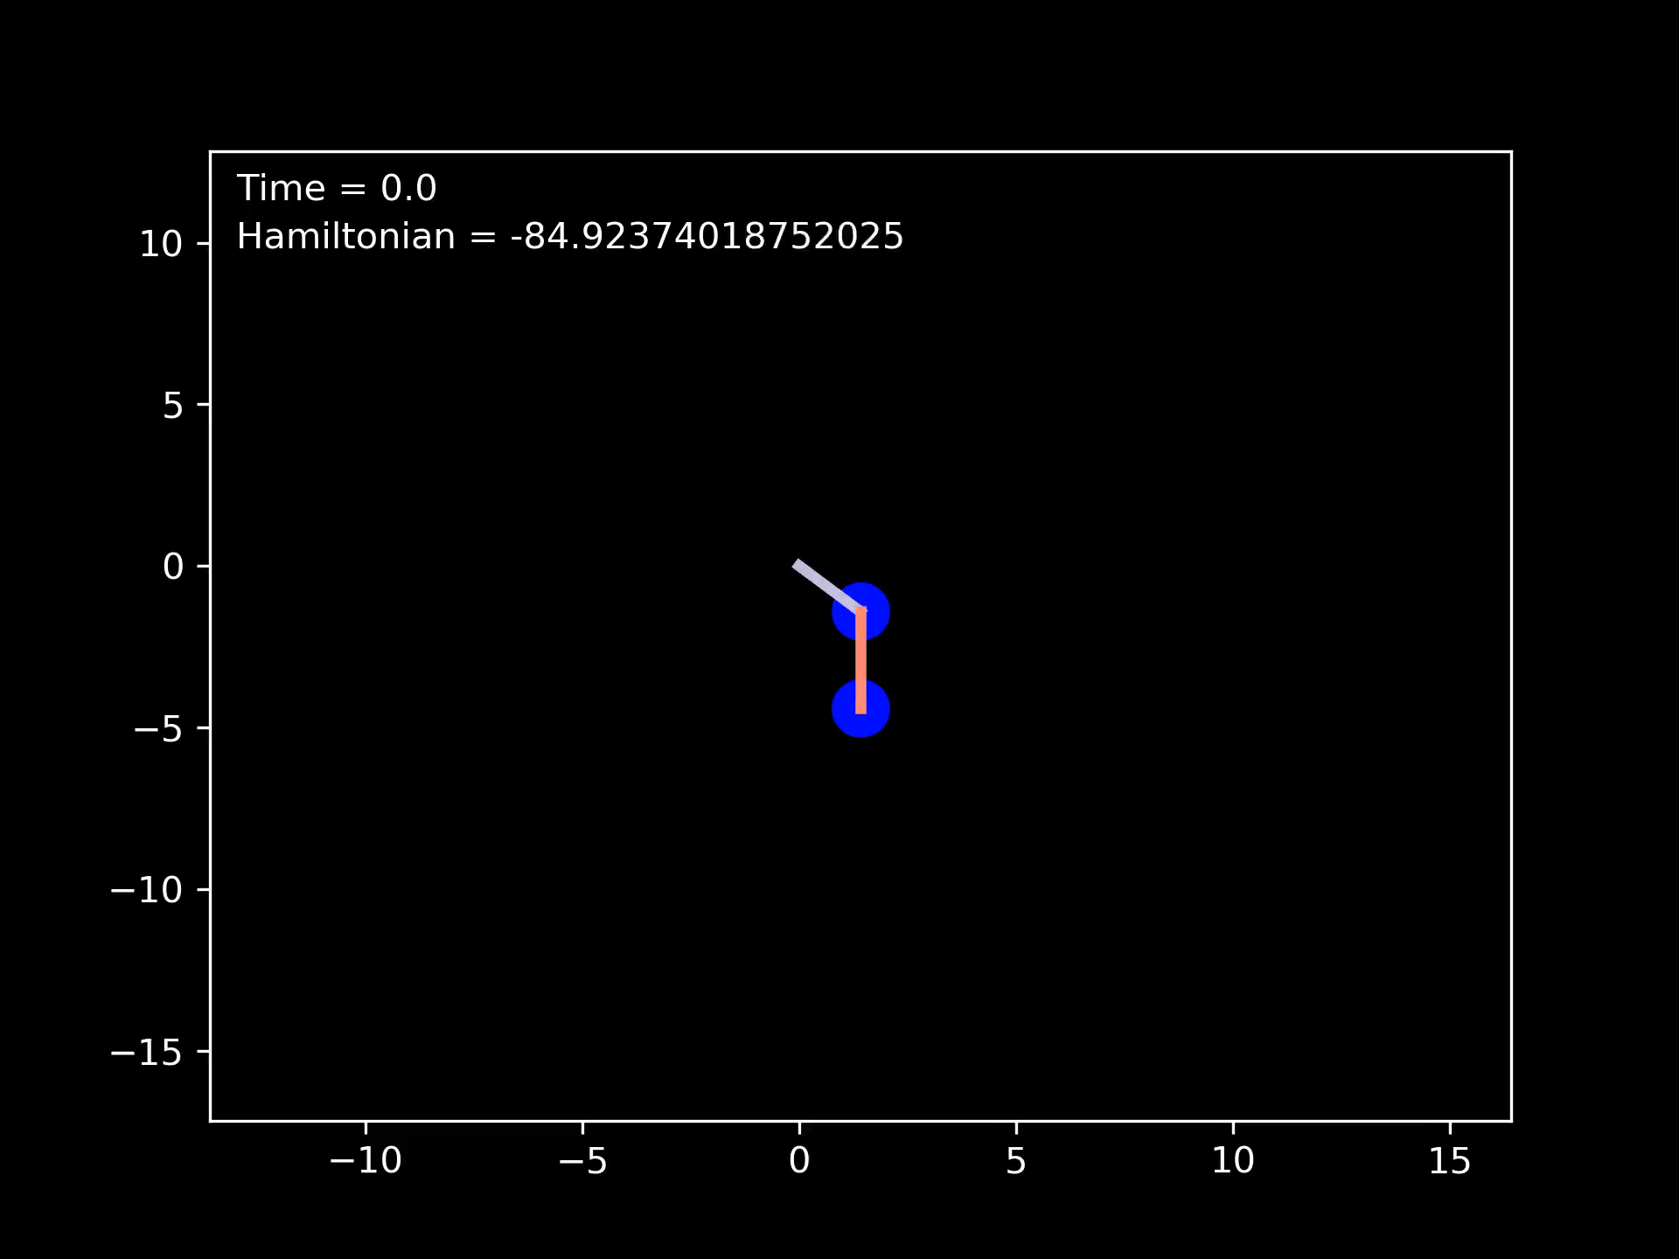
Not showing ODE for this system as it is very complicated.

Slide 17
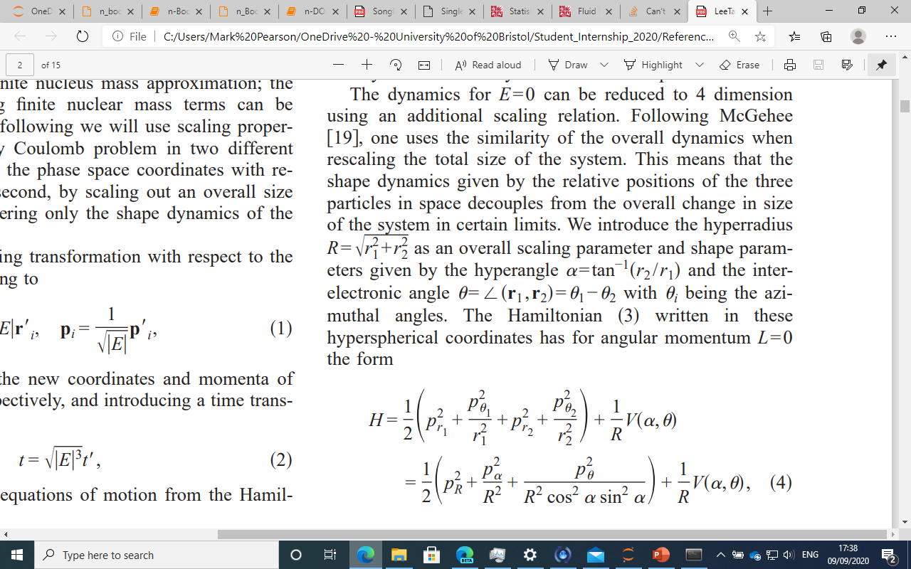
Brief Description of Hyper Spherical Cord
Hyperradius
Interelectronic angle
Hyper angle
Electron 2
r_2
Theta
Electron 1
Nucleus
r_1

Slide 18
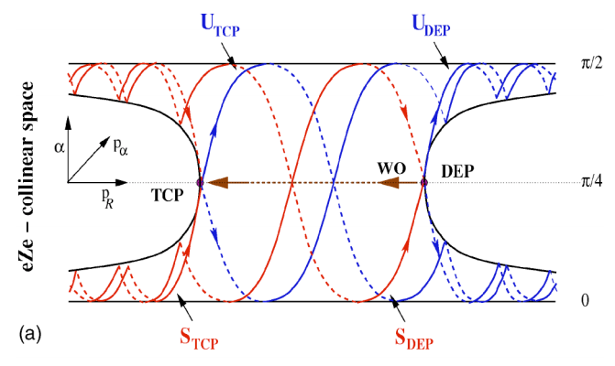
An Easy way to predict which electron escapes
This involves changing the coordinates from cartesian to hyperspherical
Kustaanheimo-Stiefel must be applied to remove the singularities
A singularity/explosion is a point where the equations are not valid, in this case when r_1 = 0
Hyperradius
Interelectronic angle
Hyper angle
When r_2 is small or r_1 is large, alpha is 0
When r_2 is large or r_1 is small, alpha is pi/2
The method that is used only works for energy <= 0
Also has to be in an eZe configuration
E = 0 on surface
E < 0 inside shape
Notes:
Explain R and theta

Slide 19
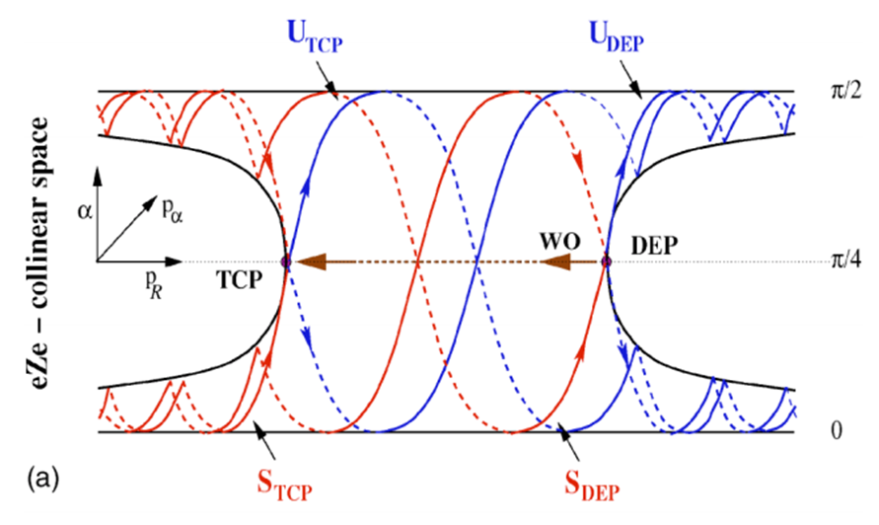
Equilibrium Points
TCP – Triple Collision Point
Where the two electrons and
nucleus occupy the same positions
DEP – Double Escape Point
Where the two electrons escape from the nucleus
Wannier Orbit
It is a hetroclinic orbit from DEP to TCP.

Slide 20
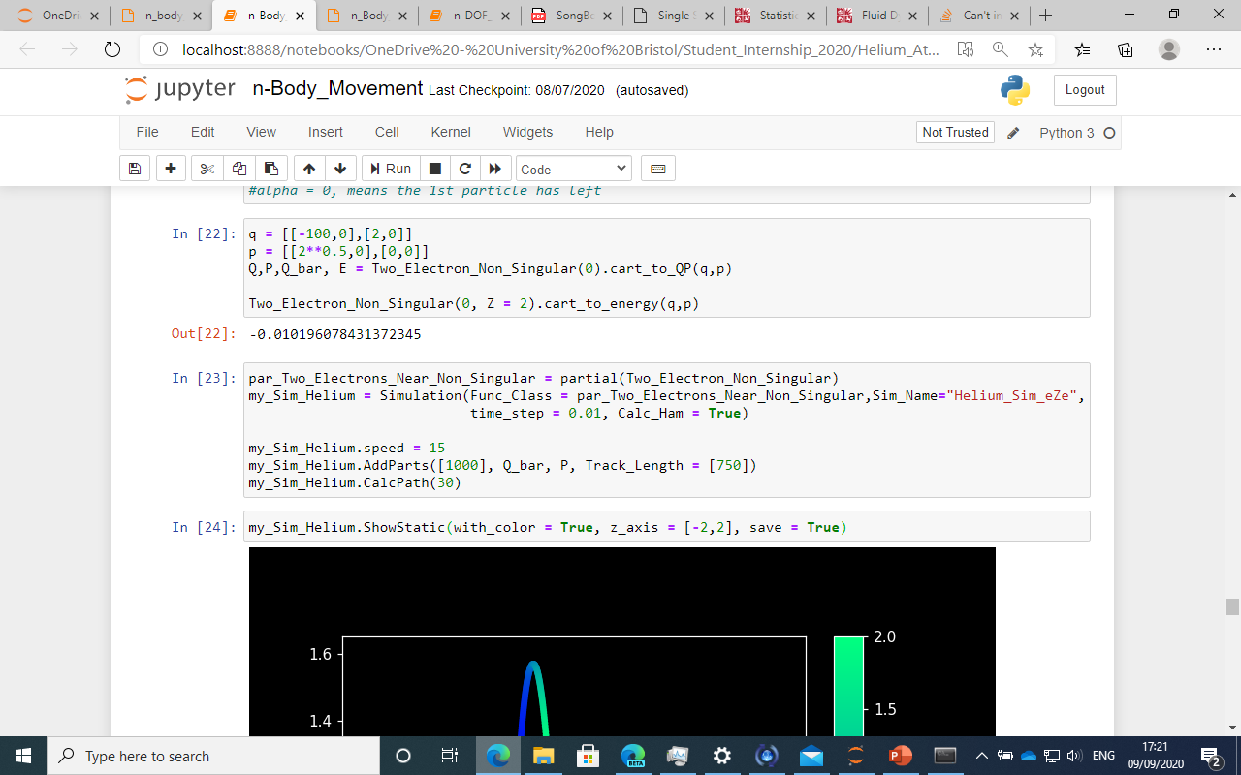
Code to simulate, in changed coordinates
Electron 1
Nucleus
Electron 2
The initial condition in cartesian coordinates looks like this
2^{0.5}
-100
2

Slide 21
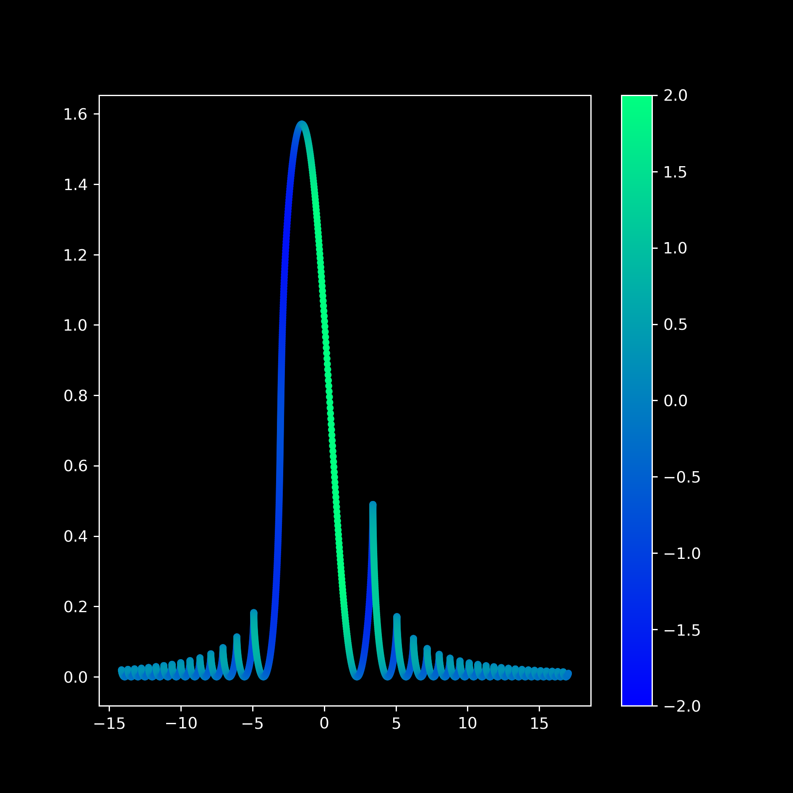
Electron 1 started very far away compared to Electron 2. (r_1 is big thus alpha is small)
Bumpy at start and end, because Electron 2 is bouncing of the nucleus changing the alpha value.
The peak occurs when Electron 1 has collided with the nucleus
In this case Electron 1 is the electron that escapes.

Slide 22
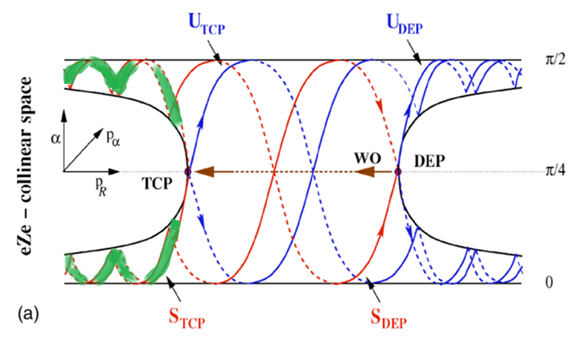
But we can predict this
Only valid when p_R < TCP and when E=0
If the initial condition is in the thin band created by the Stable TCP and Stable DEP, then the other electron is ejected. This is denoted by the green ribbon.
Otherwise, the electron coming in is the one that will leave.
But it is easier to simulate
Need the stable of the TCP(Triple Collision Point)
Need the stable of the DEP(Double Escape Point)
Notes:
Equilibrium points
Move psos video
More info on LD

Slide 23
Stable Manifold of The DEP for Helium Atom (PSOS)
Used the maths cluster cream to generate the video
Can’t display 3D image clearly on 2D screen
So cross sections were taken which is the same as Poincaré surface of section (PSOS)
This took a long time so the screen command had to be used, to stop ssh connection from timing out.

Slide 24
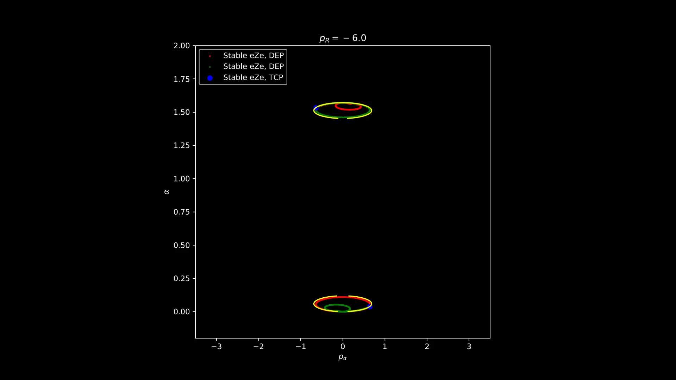

Slide 25
The Runge–Kutta method
Runge-Kutta was used to calculate numerical solutions of ODE.
The Trapezium rule was used for numerical integration to find area.

Slide 26
Extras
Stable Manifold of The DEP for Helium Atom (PSOS)
Lagraingian Descriptors

Slide 27
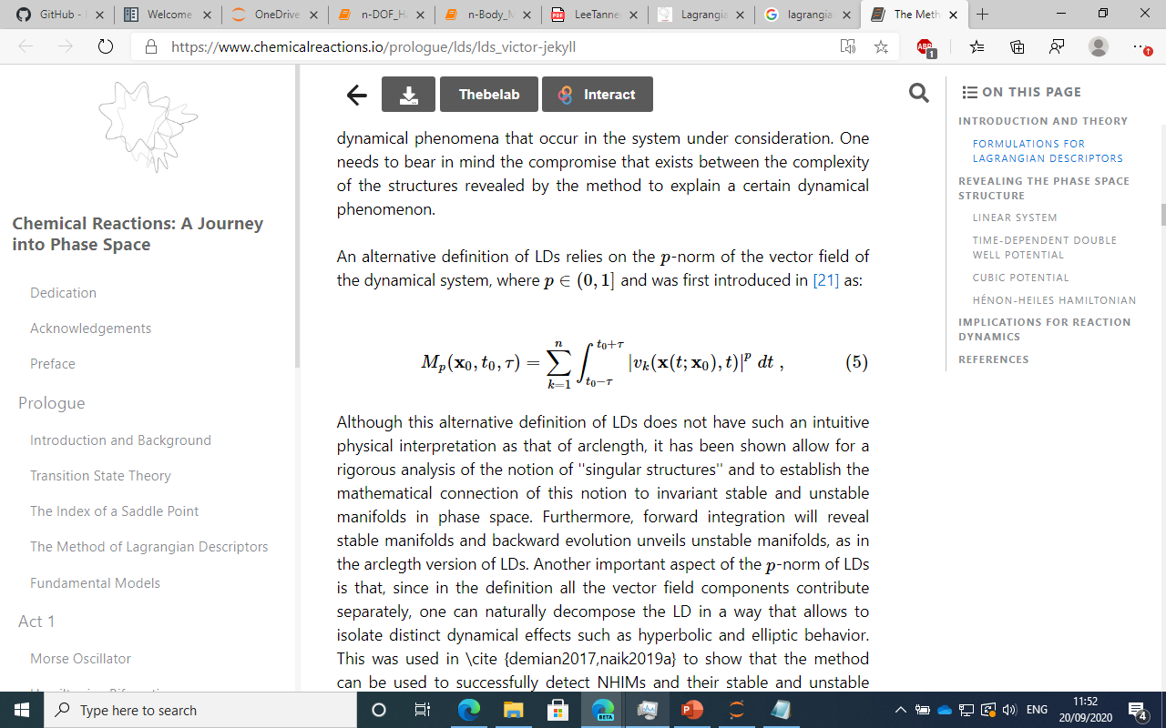
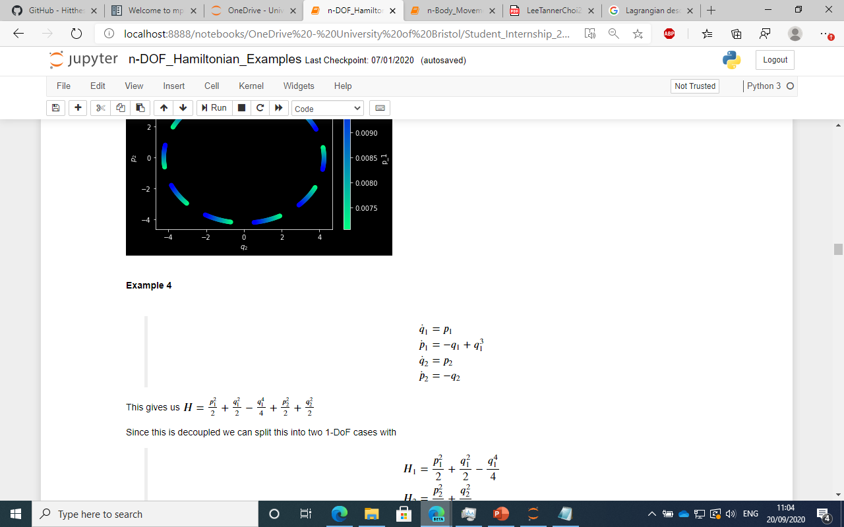
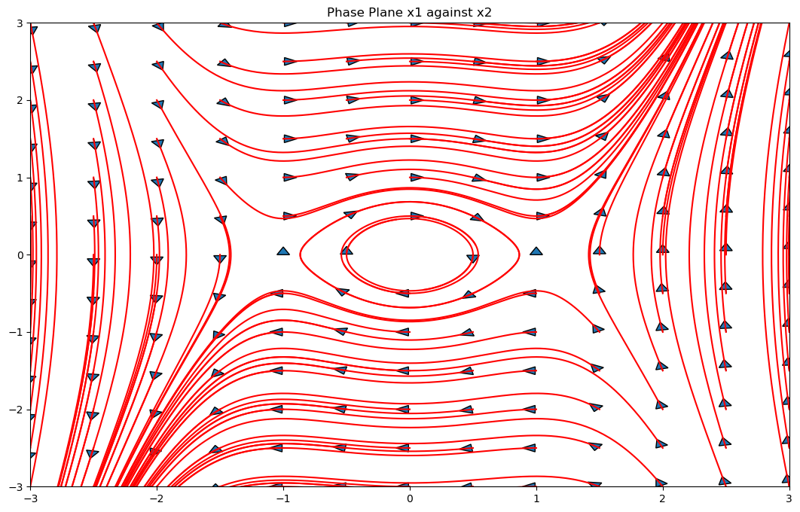
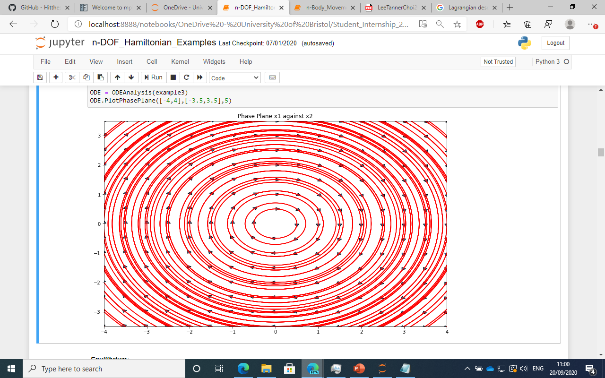
Lagraingian Descriptors
Explains the geometrical template of phase space structures
We will look at disjoint system
Analyse hemisphere formed by q_1 = 0, \dot{q}_1 > 0
Take p = 0.5, t₀ =0
For a given initial condition it calculates the lagraigian descriptor at that point.

Slide 28
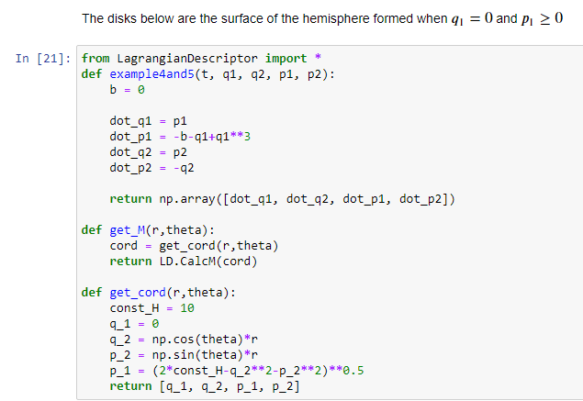

Slide 29
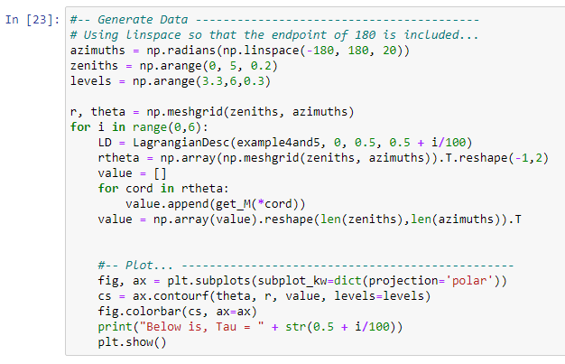
On the next slide is the output

Slide 30
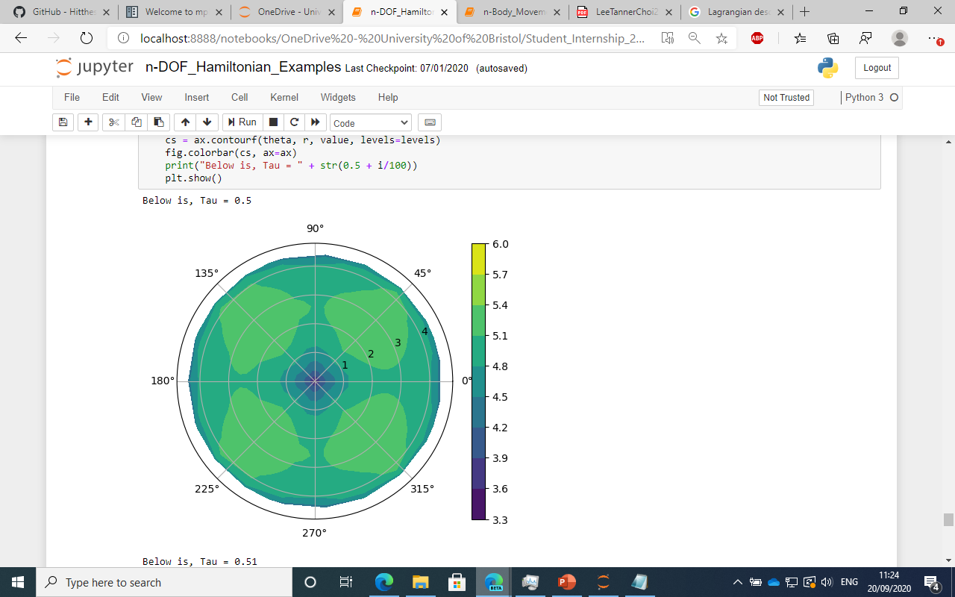
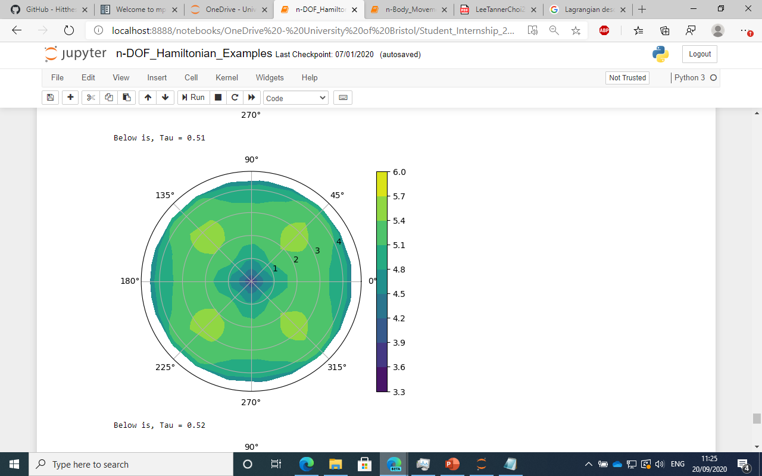
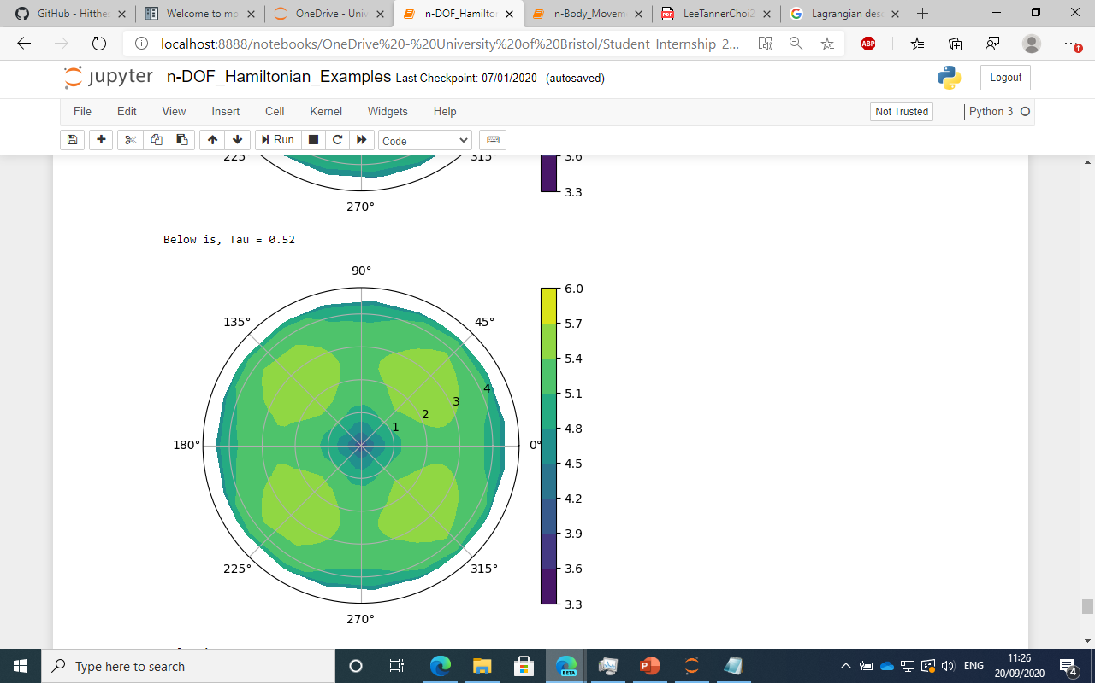
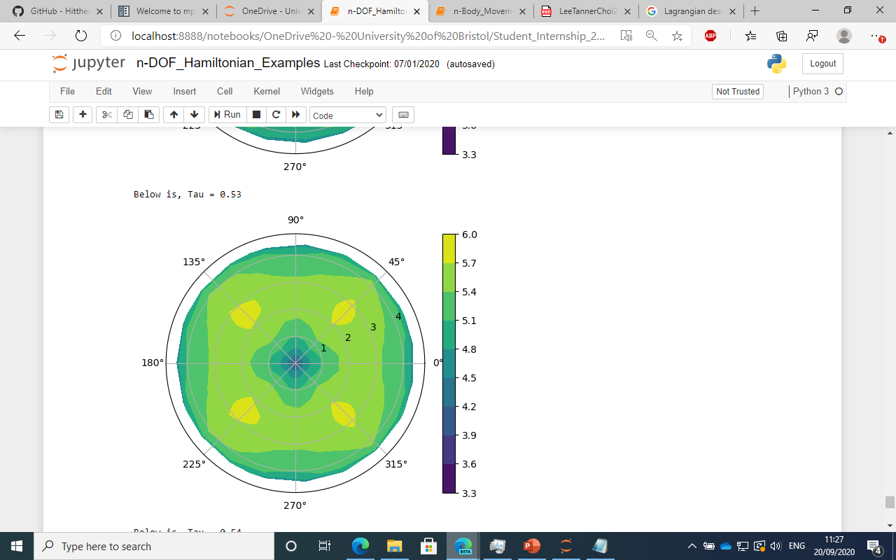
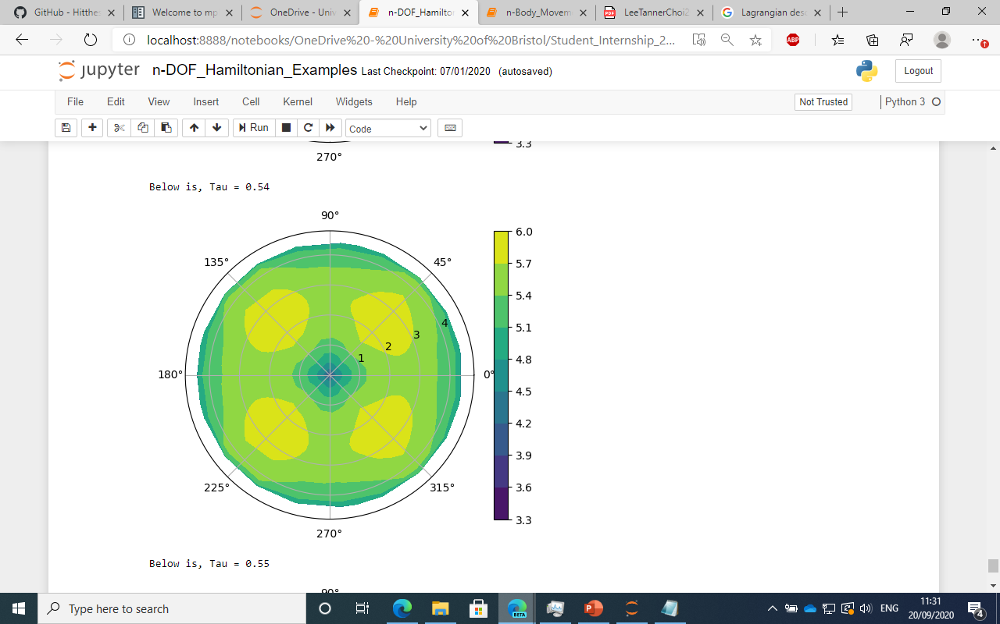
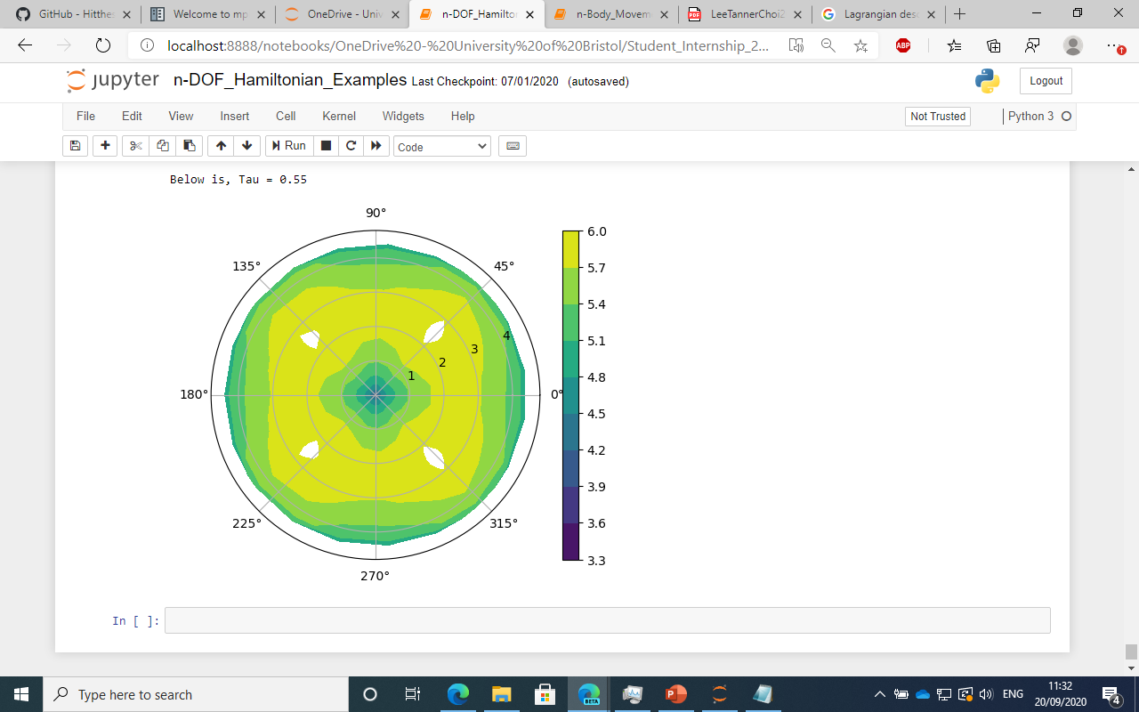

Slide 31
Where can you find the work
Github page for project: https://github.com/Hitthesurf/Helium_Atom
mpl_trajectory PYPI: https://pypi.org/project/mpl-trajectory/
mpl_trajectory github: https://github.com/Hitthesurf/mpl_trajectory
Spaces have underscores

